Slide 1
Agentic RAG Chatbot using MCP
- Presented by Achanta Krishna Vardhan

Slide 2
Workflow
-> Upload a document in the Streamlit UI.
-> Ingestion Agent extracts and chunks text, embeds with Sentences Transformers, and stores in FAISS.
-> Retrieval Agent retrieves top-k relevant chunks and reranks them.
-> The LLM Response Agent uses retrieved context and the user query to generate an answer via Ollama.
-> The MCP Broker manages communication between agents.
-> The final answer appears in the chat interface.

Slide 3
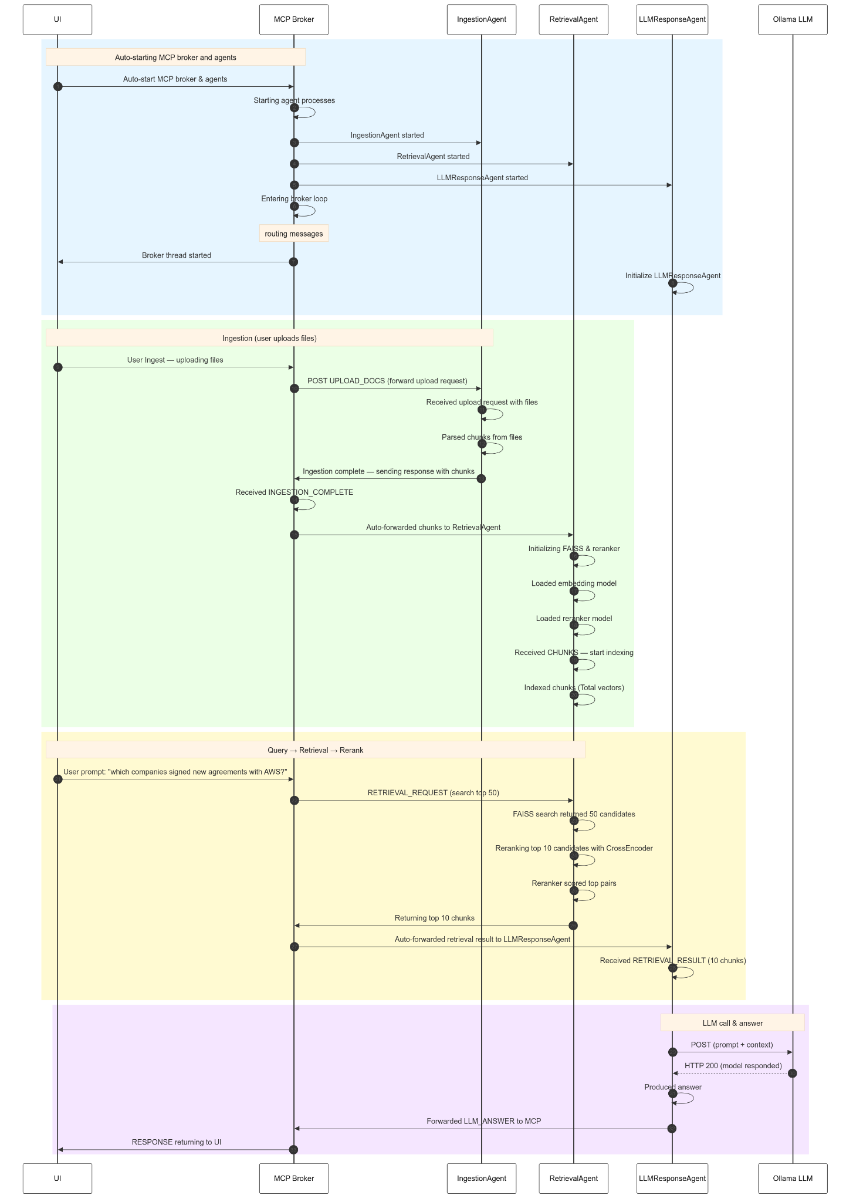

Slide 4
Tech Stack Used:
Frontend: Streamlit -> for the chatbot UI
Core Orchestration: Python Multiprocessing → for running the agents (Ingestion, Retrieval, LLM) as separate processes and for communication
MCP Broker: manages message routing between agents.
Document Processing: LangChain → Recursive Character Text Splitter for chunking documents into passages.
File Parsing Libraries: pdfplumber, python-pptx, python-docx, pandas
Vector Store & Retrieval: Sentence Transformers, Embedding Model: all-MiniLM-L6-v2, FAISS,CrossEncoder: ms-marco-MiniLM-L-6-v2
LLM: Ollama -> llama3.2:1b

Slide 5
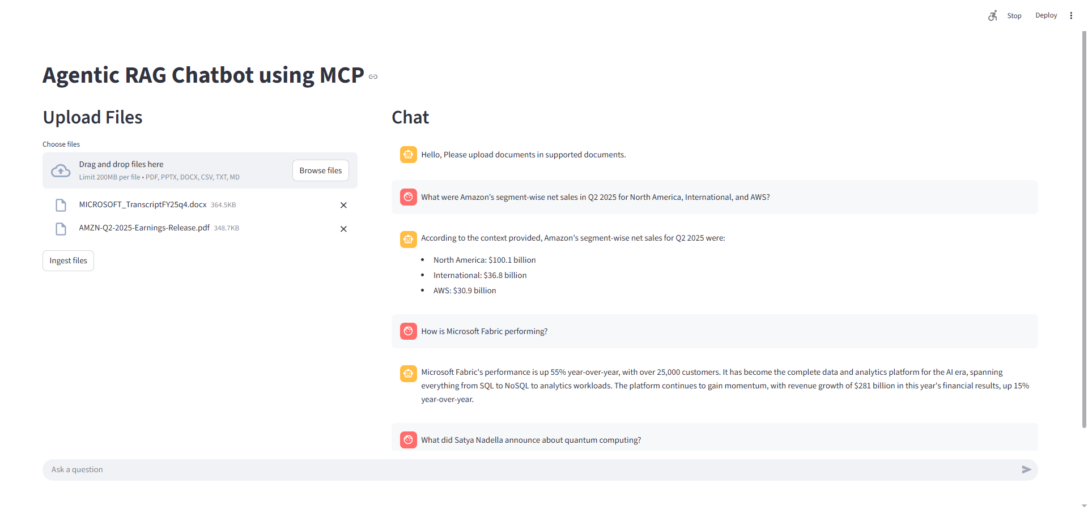

Slide 6
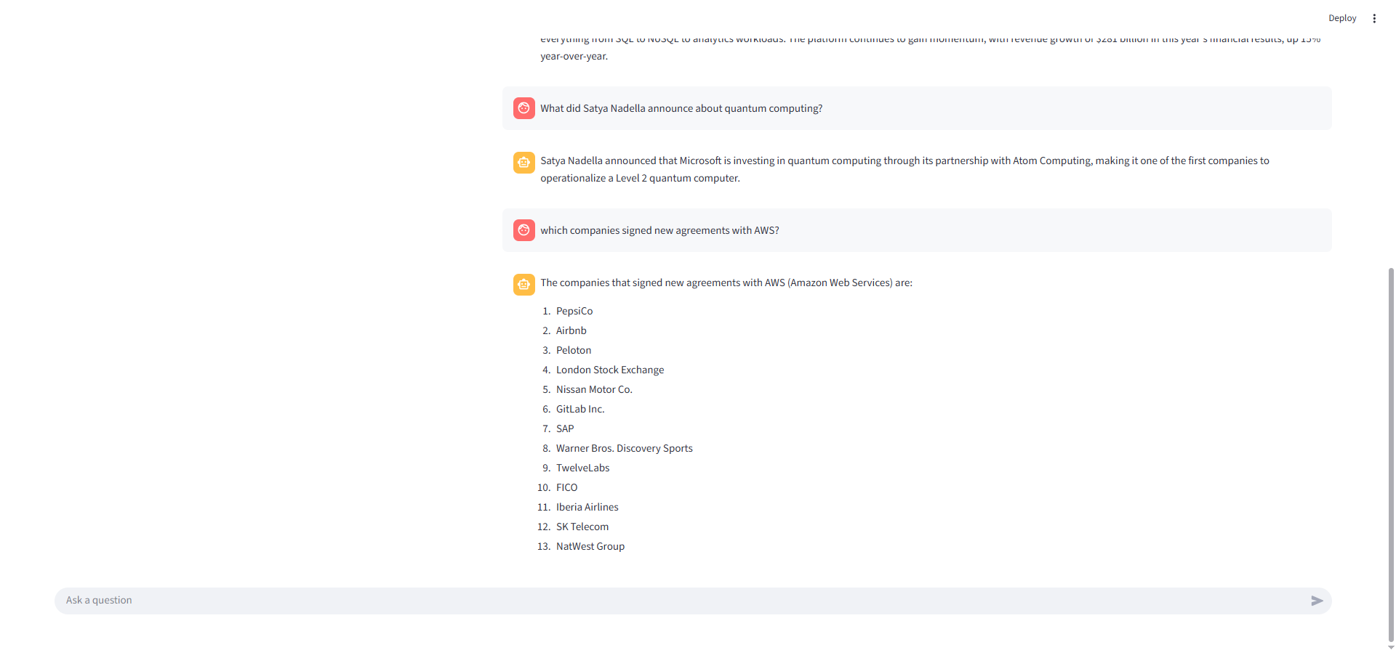

Slide 7
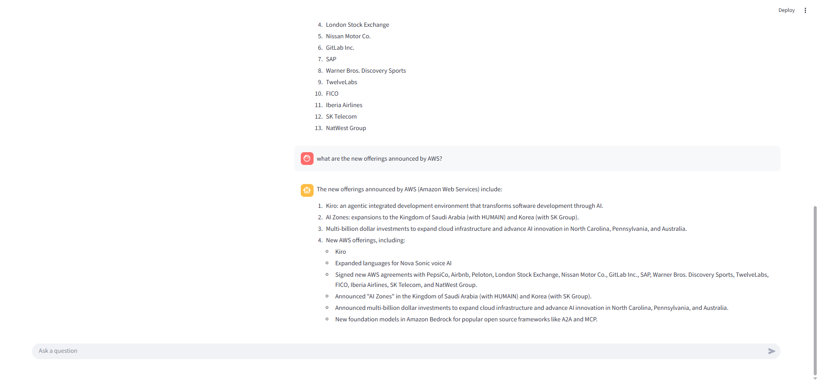

Slide 8
Challenges Faced - 1
I initially used the Mistral 7B model, which was heavy and produced responses very slowly. I then shifted to the LLaMA 1B model, and now the response speed is much better.
At first, the chunk size was either too small or too large, which caused loss of context. The cross-encoder re-ranker sometimes mismatched embeddings, lowering retrieval quality. I tuned the chunk size to 800 with an overlap of 100, balancing context and accuracy.

Slide 9
Challenges Faced - 2
The system was slow, and I couldn’t tell if the delay was from ingestion, retrieval, or the LLM. I added detailed logs to each step, which helped me find issues and made debugging easier.
If I set K_RETRIEVE / K_RERANK too high, it pulls in irrelevant results and reduces accuracy; if too low, it misses context and gives wrong answers. After testing different settings, I ended up with K_RETRIEVE = 50 and K_RERANK = 10, which worked well.

Slide 10
Future Improvements - 1
Currently, CSV search doesn’t work well because chunks lack header context, so the retrieved text may not convey meaning properly, adding CSV header info to each chunk will make searches much more accurate.
Vector search now uses direct embedding similarity, but accuracy can be improved with hybrid retrieval (semantic + keyword) or advanced vector DBs for more relevant results.
Make sure numbers like amounts, percentages, and years are handled properly so they’re extracted, stored, and retrieved accurately.

Slide 11
Future Improvements - 2
Train the model on domain-specific data like financial reports, transcripts, CSV datasets, and FAQs so it learns the right vocabulary and reasoning patterns, resulting in more accuracy.
Chunking is currently fixed-size, which can miss context; using LLM-assisted chunking would create better context windows, improving retrieval and answer accuracy.

